Slide 1
Kindergarten
at Harbour View
Starting Kindergarten
is an exciting time for children and their families.

Slide 2
Welcome to Kindergarten Bag
Contained within the Welcome to Kindergarten Bag is lots of information regarding the Kindergarten program at Harbour View. Please review all the documentation that is included in the Welcome to Kindergarten Bag.
The learning tools that are provided within the Welcome to Kindergarten Bag are carefully designed to support early learning at home. Please watch the “Learning Through Play” videos and the corresponding activity cards that are featured on the following page, which offer wonderful suggestions on how to use these early learning tools. The Family Activities for Early Learners Resource Book included in print format in your bag, offers further play based activities to enjoy! Play is an important factor in early childhood development and learning. The Welcome to Kindergarten resources are developed and created with play in mind. Just Playing is a ‘must share’ poem that we are proud to share with you. It illustrates just how children develop and learn through play.

Slide 3
Early Learning Tools
The Early Learning Tools that are found in your Welcome to Kindergarten Bag were carefully selected to support early learning in the home. Below are five cards with questions that will help guide you and your child through important early learning activities to prepare for Kindergarten. Encourage your child to explore the world through colour, letters, nature, play dough and storytelling. These cards can be printed off by following the blue linked words below.
Colour Hunt Letter Hunt Nature Collage Play Dough Recipe Playful Storytelling

Slide 4
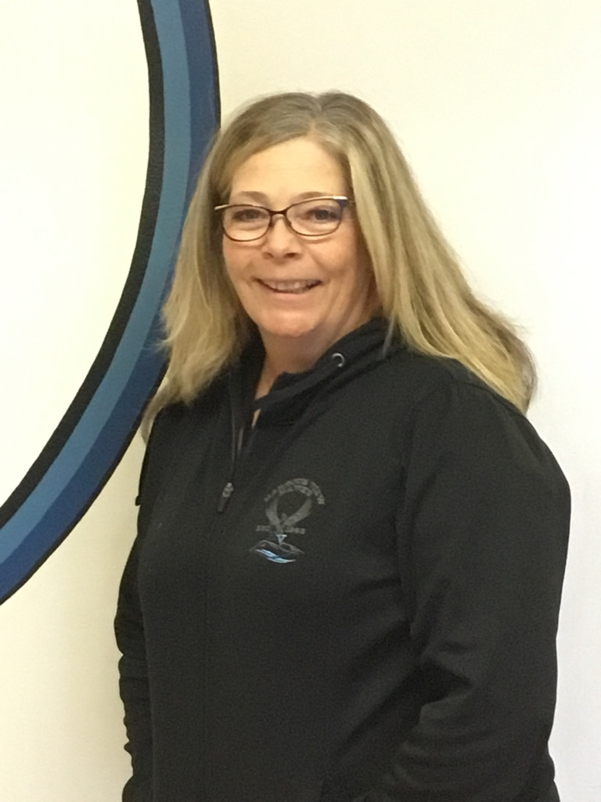
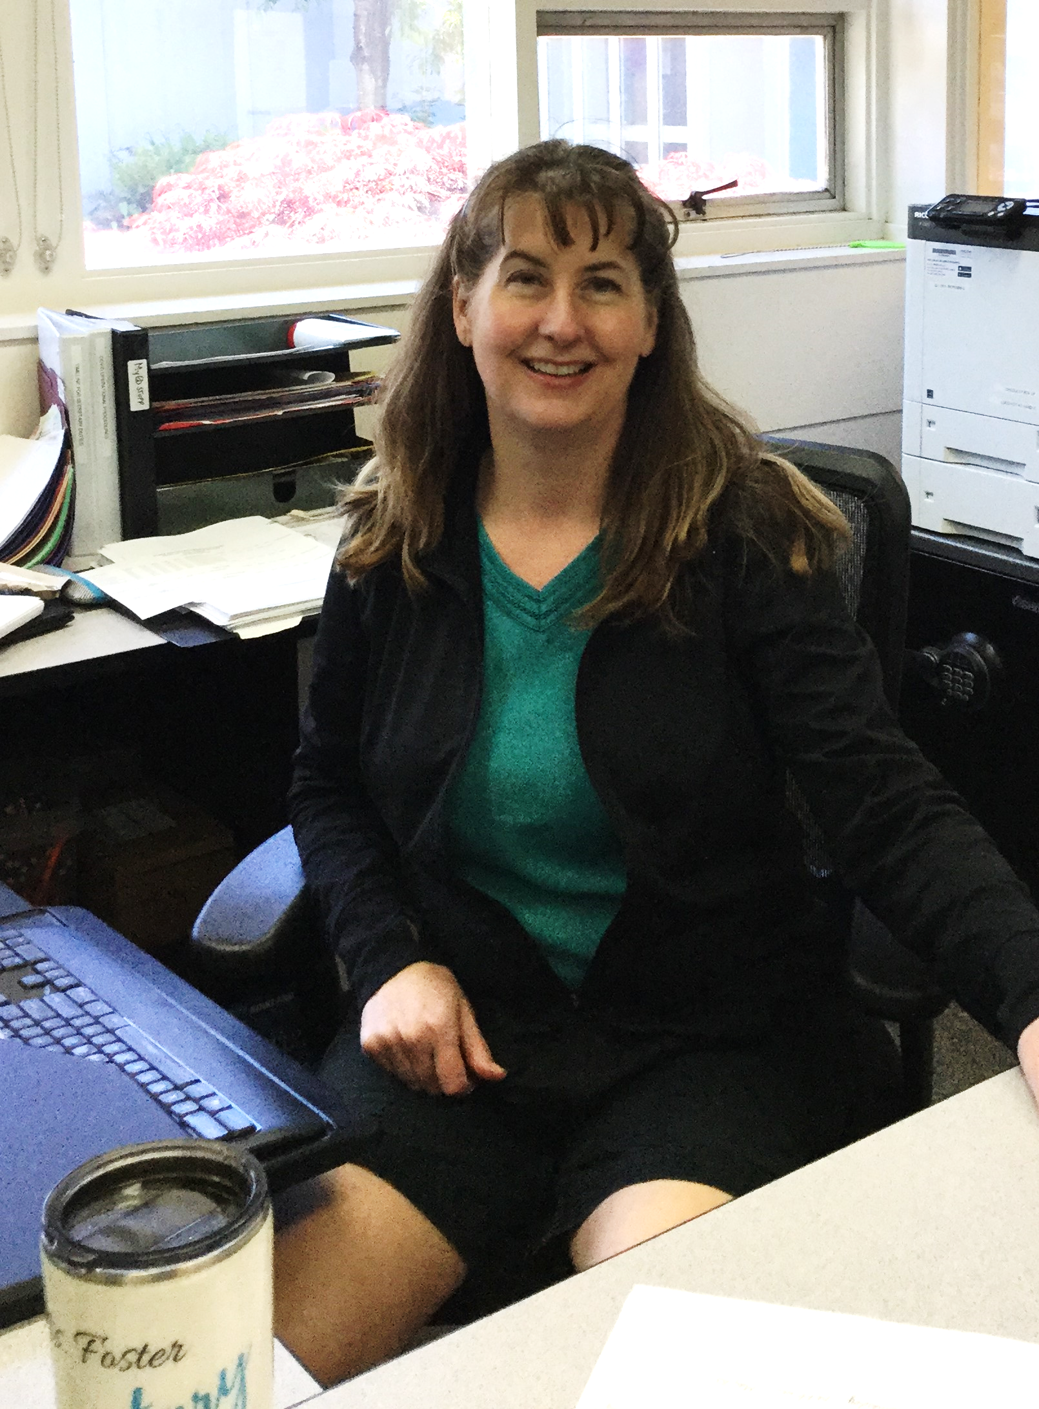
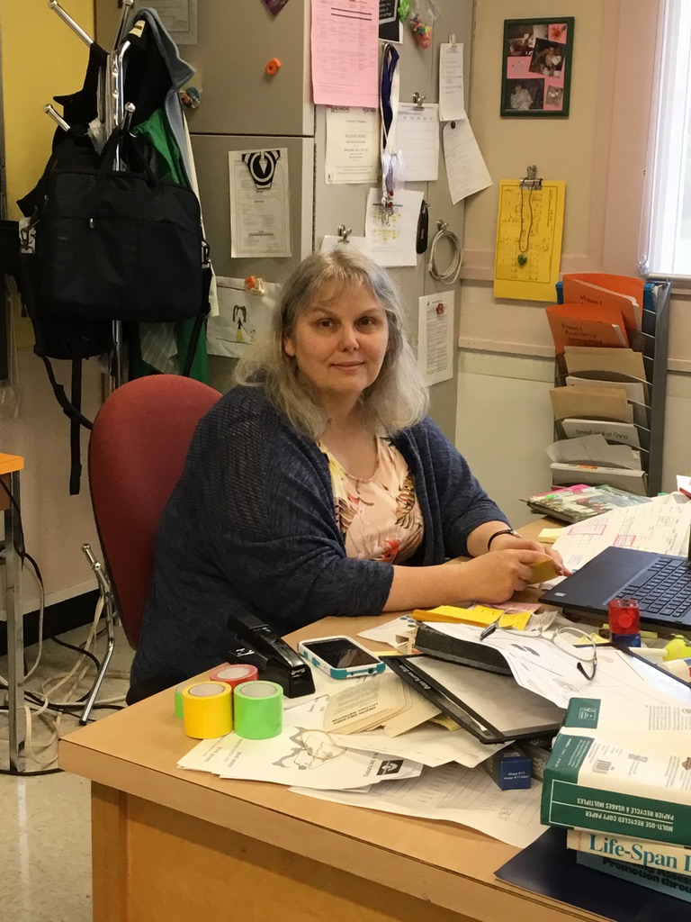
Some of the People You Will Meet
Mrs. Foster
Our secretary
Ms. Pleasants
Our Learning Support Teacher
Ms. Woods
Our Principal

Slide 5
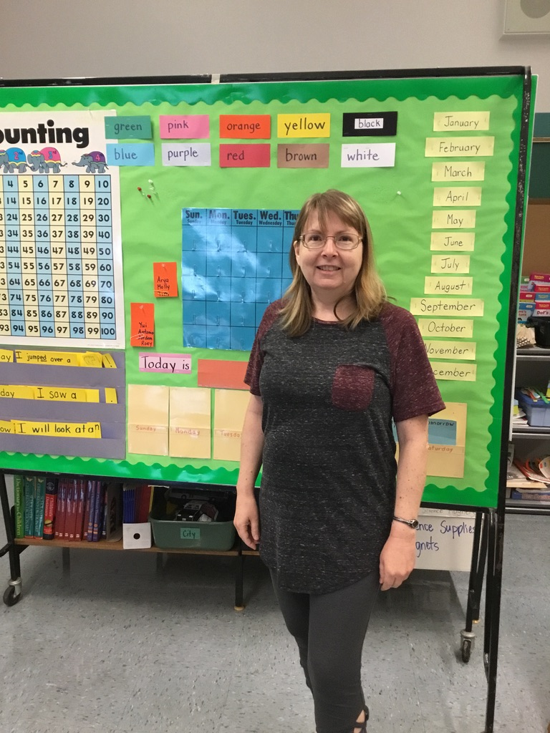
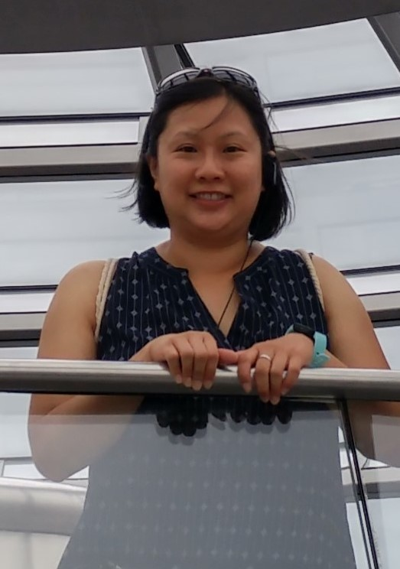
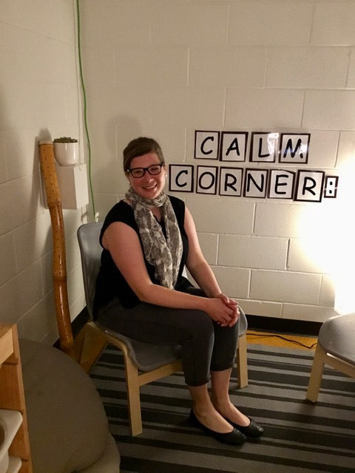
Some of the People You Will Meet
Ms. Cassidy
Our Learning Support Teacher
Ms. Lee
Our Learning Support Teacher
Ms. Kopf
Our School Counsellor

Slide 6
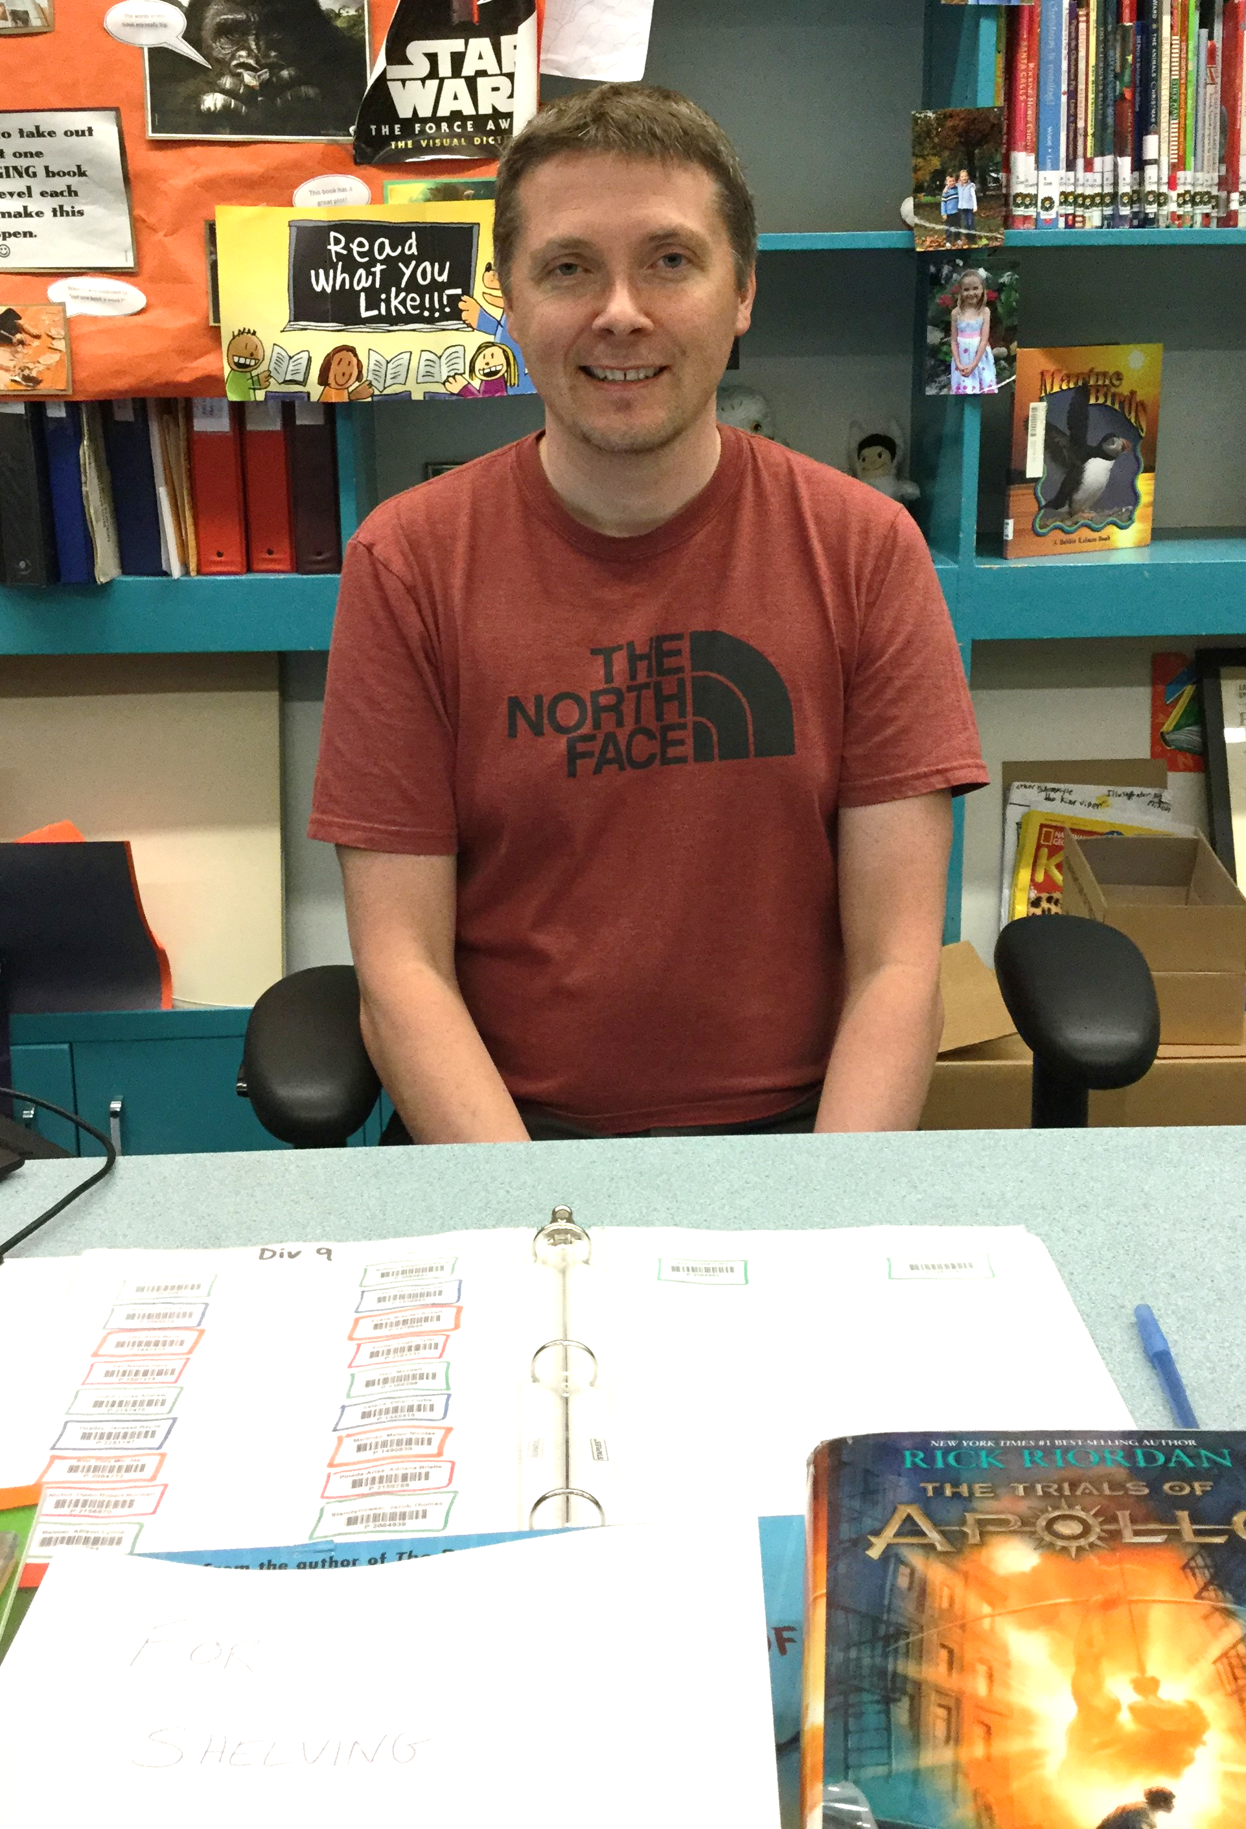
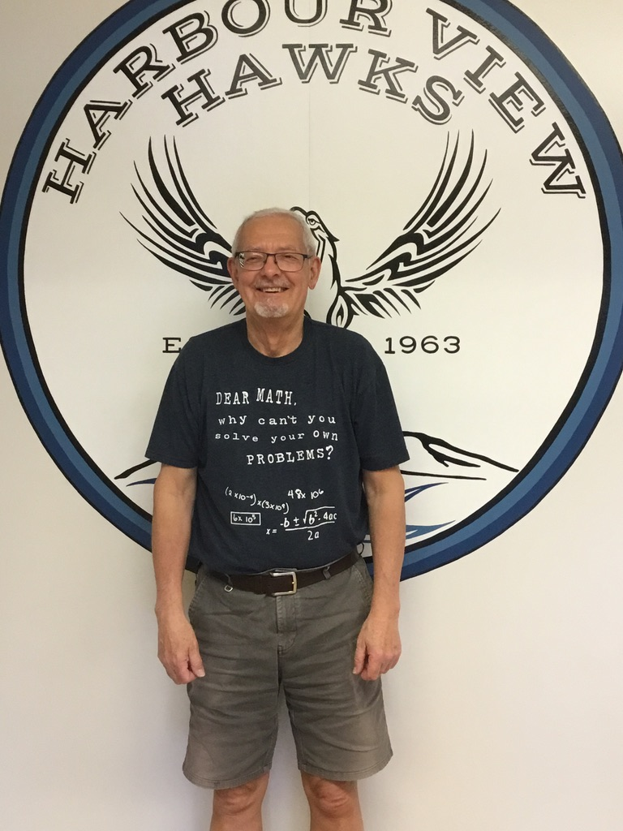
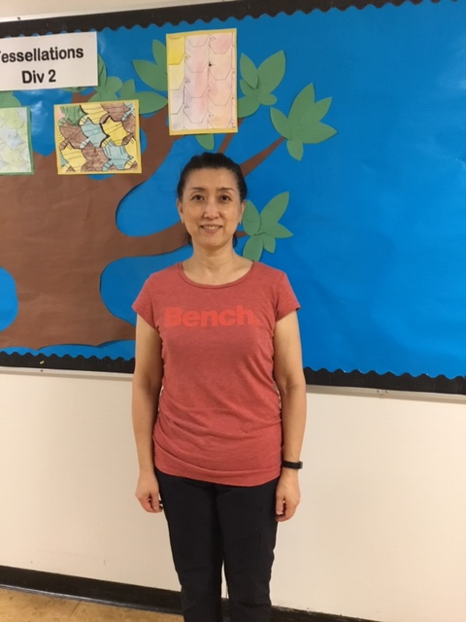
Some of the People You Will Meet
Mr. Drake
Our Library Teacher
Mr. Cropper
Our Afternoon Custodian
Ms. Kwon
Our Morning Custodian

Slide 7
In Kindergarten…
…we love to build, construct, create and work together with our friends.

Slide 8
We love to have visits from community helpers…
…and to go on special field trips with our friends.

Slide 9
We love to investigate living things…
…and explore nature in the garden with our friends.

Slide 10
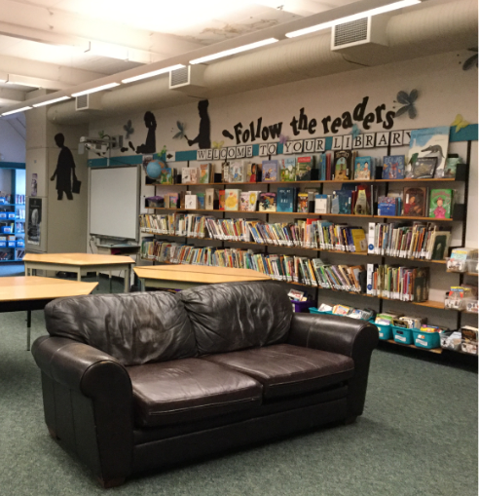
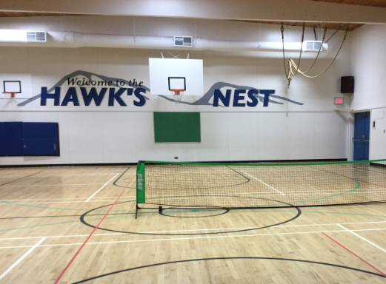
We love to play games in the gym …
…and explore new stories in the library with our friends.

Slide 11
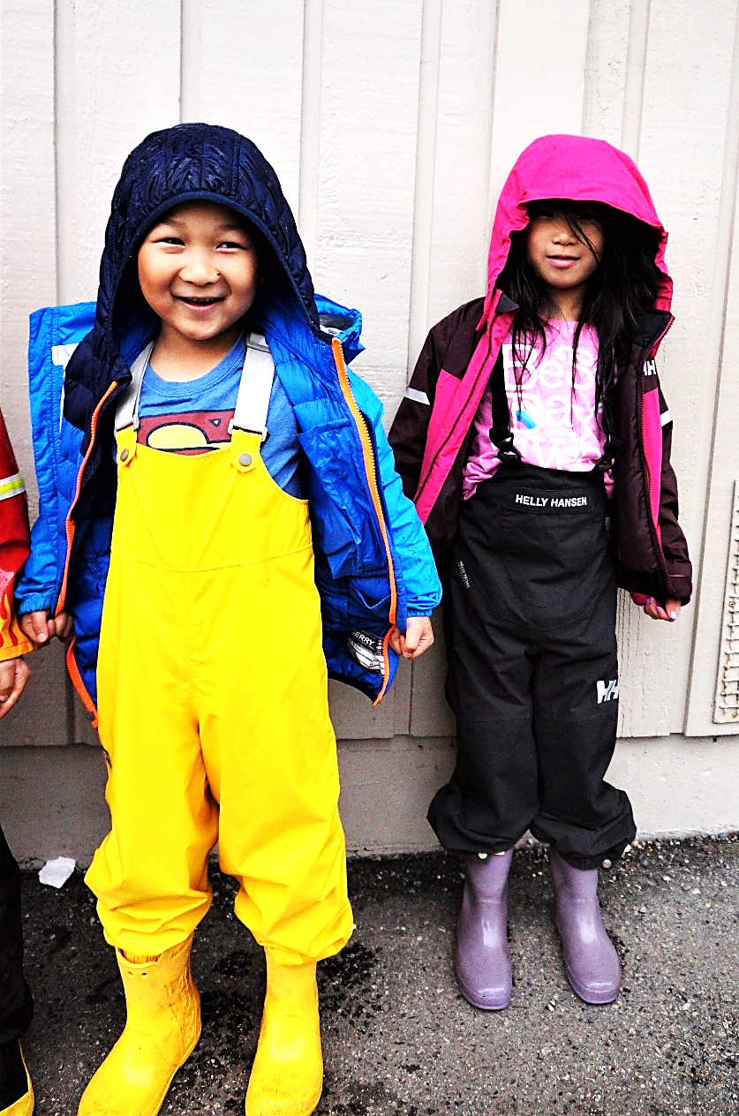
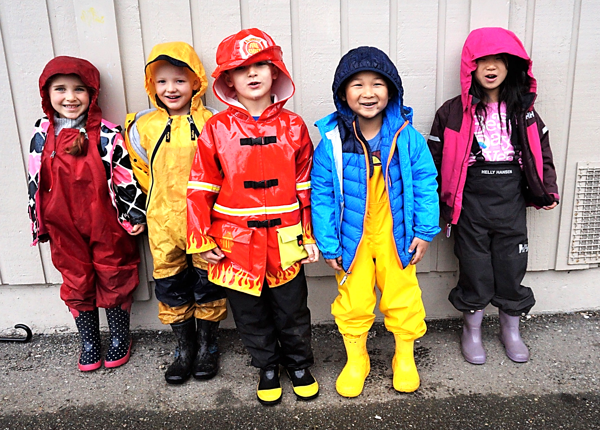
We love to play and learn outside in all …
… kinds of weather with our friends. We are ready for the "Wet Coast" weather!

Slide 12
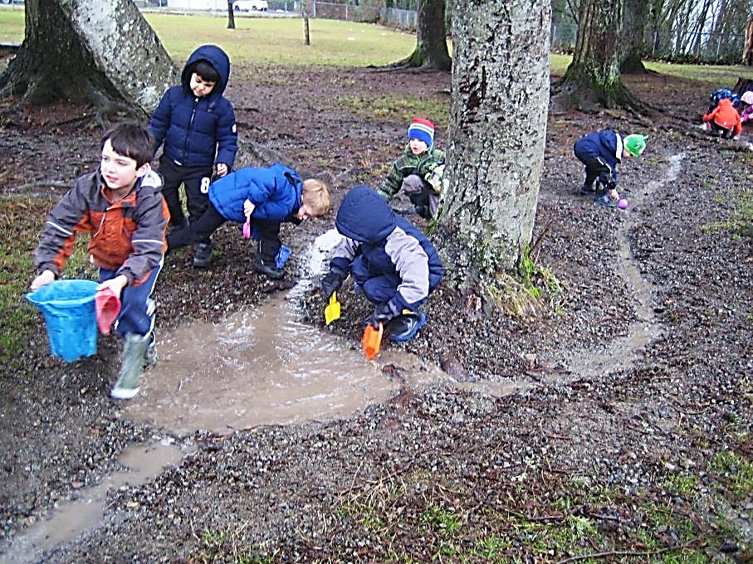
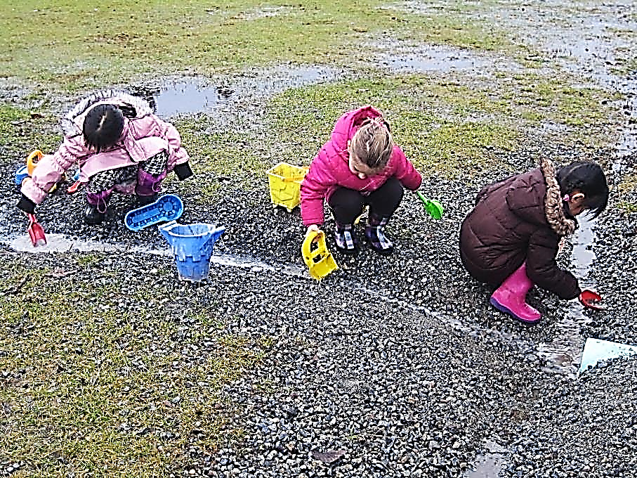
We love to build, explore and experiment…
… with streams and puddles with our friends. Rain boots and jackets are a must!

Slide 13
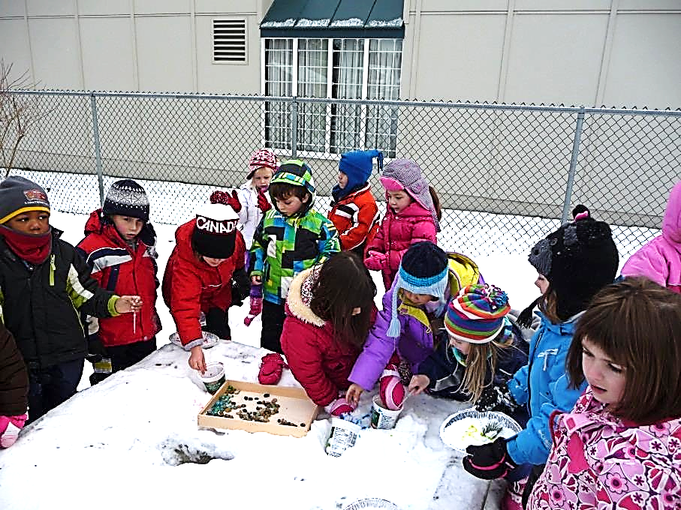
We love to play and create no matter…
… if we are inside or out with our friends. Toques, Jackets and Mittens – Oh, my!
Notes:
Inside o

Slide 14
Information for Families
The following slides contain information about the Kindergarten Program. .

Slide 15
Kindergarten Home Responsibilities
Children love to be “big kids” and help their families. In order to help develop independence and self-reliance in your child, this is the age to introduce simple responsibilities. The list below, are some typical Home Responsibilities, perfect for your Kindergarten child:
Making their own bed and keeping room tidy.
Dressing on their own and choosing own clothes for the day.
Answering the telephone and beginning to dial the phone.
Taking out the garbage.
Helping set the table.
Putting on their shoes.
Cleaning up after snack.
Separating clothes for wash into colour piles.
Putting toys away.

Slide 16
Kindergarten School Responsibilities
Now that your “big kid” is in Kindergarten, they also have responsibilities at school. In order to help develop independence and self-reliance in your child, help teach and let them take on their school responsibilities.
Your Kindergarten child must learn to:
Carry their own backpacks.
Put on their own jackets, rain pants and shoes.
Learn to fix reversed sleeves and pant legs that are inside out.
Practice using buttons, snaps, zippers and velcro.
Open and close their lunch kits, containers and packages.
Feed themselves and clean-up any messes from eating.
Be responsible for returning notices and library books.
Going to the washroom independently.

Slide 17
Your Child's Health is Important
Your child’s health is important and directly effects their ability to learn, play and make friends in school. Below are some areas that are particularly important.
Please help your child:
Get enough sleep (10 – 12 hours.)
Eat a balanced diet (especially a protein rich breakfast.)
Develop habits of cleanliness and independent personal hygiene.
Have eyesight, hearing, teeth and general health checked.
Update their immunizations.
Keep them at home when they are ill (phone the school and let them know of their absence.)

Slide 18
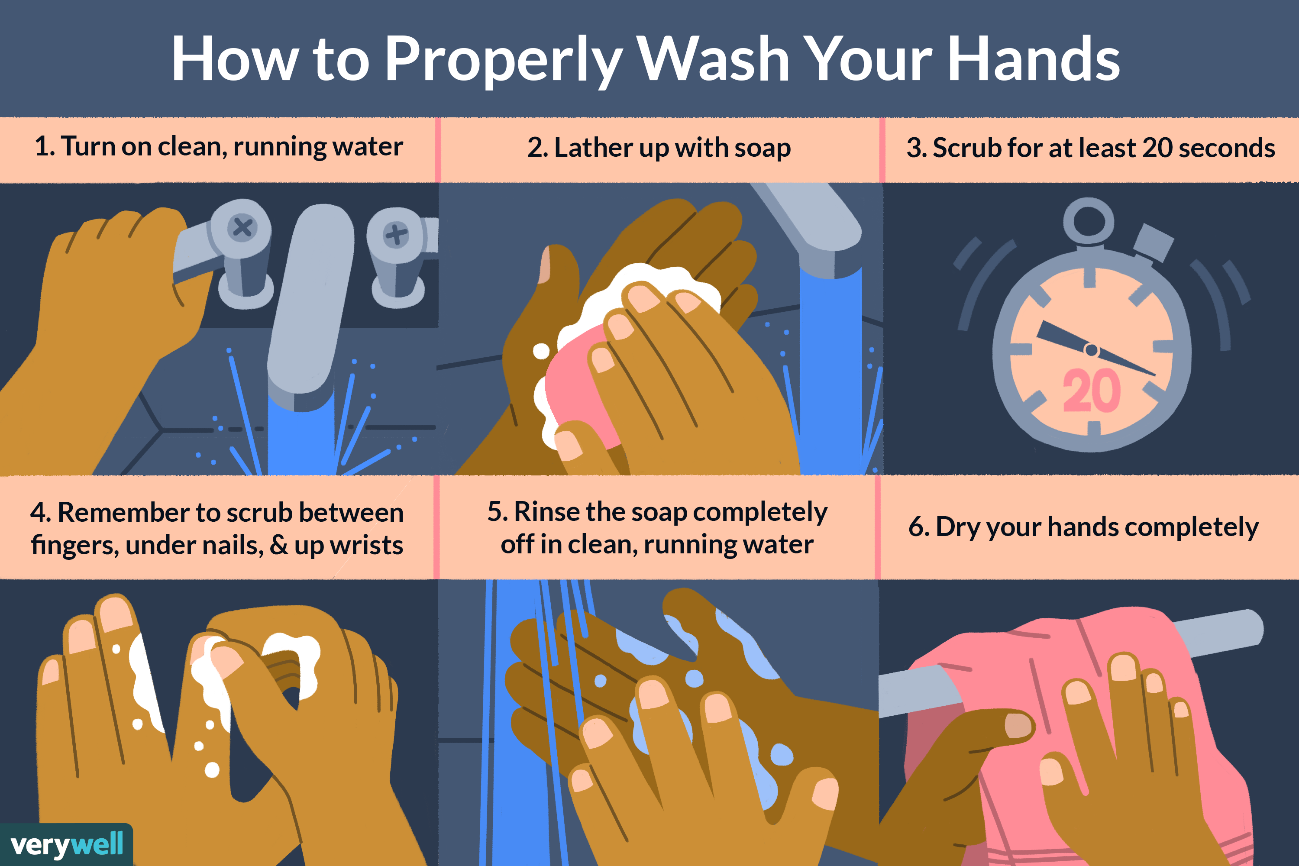
Washing Hands is Essential
It is essential that your child can independently and thoroughly wash their hands to prevent the spread of germs.
Children should be washing their hands for 20 seconds. If possible, please teach your child to wash their hands to one of these catchy songs.
Alternatively, have your child sing the ABC Song twice while washing their hands.

Slide 19
Washroom Independence
Washroom independence is mandatory for all students. Teachers will not toilet your child. From time to time, children will have accidents… this is normal. To the best of your child’s ability, they need to be washroom independent.
Your Kindergarten child must be able to:
Clearly tell the teacher when he/she needs to go to the washroom, before it is too late.
Pee and poo independently.
Must be able to poo while sitting on the toilet.
Wipe independently after going pee or poo.
Re-dress after using the washroom.
Thoroughly wash his/her hands after each bathroom use.
Teachers will not toilet children.

Slide 20
Sleep Health
Sleep is one of those things we all need. In children, sleep is critical for their physical, social-emotional, and academic development. Kids (and adults) who get enough sleep are happier, calmer and more responsive to everything that happens in life.
Kids need up to 10 - 12 hours of uninterrupted sleep each night.
Kindergarten kids should be in bed and sleeping by 8:00 pm, on school nights.
Try to start the bedtime routine at about 7 or 7:30 pm.
There is NO nap time in Kindergarten.
Good parents need evening “down time” from your kids. Do not feel guilty about putting your kids to bed at 8:00 pm and enjoying a little free time without the kids. You deserve it and need it. Parenting is the hardest job you will ever have.

Slide 21
Eating Independence
At school, your child will need to develop independence while eating. Lunch and Recess is an exciting part of the day, often your child’s favourite part of the day. Sometimes, it is hard to balance socializing with their friends and eating their food within a limited time span. We purposefully extend our eating times within the classroom to support your child in developing a healthy eating routine at school.
At home, please support your child in developing good eating habits at school:
Practice opening and closing lunch kits, containers, and packages. Send only easy to open containers.
Send food that your child will eat Independently and quickly.
Practice eating within a snack time of 15 minutes and a lunch time of 25 minutes.
Prepare snacks and lunches together the night before, as when children are involved in the planning, they are more likely to eat the food.
Label RECESS snack and LUNCH… so that your child does not eat everything at once.
Send nutritious protein rich food.
Forks and spoons should be sent from home. We do not heat up food.

Slide 22
Pack It In and Out
We are a Pack It In & Pack It Out school.
That means…
We are reducing garbage, compost and recycling at school.
All peels and wrappers will be sent home in your child’s lunch kit.
It is recommended that your child has a Ziploc bag to carry home garbage, compostables and recycling items.
At home, practice rinsing containers, putting peels and garbage into a bag.
Practicing at home develops independence at school.

Slide 23
Snapshot of a Kindergarten Day
8:58 ~ Morning routine
10:15 ~ Recess snack with Teacher.
10:30 ~ Outdoor recess with Adult Supervisors. Teacher break
10:45 ~ Return to classroom.
11:45 ~ Begin eating lunch with Teacher.
12:00 ~ Continue eating lunch with student monitors and prepare for outside time.
12:15 ~ Outdoor play with Adult Supervisors.
12:00 to 12:50 ~Teacher break
12:50 ~ Return to classroom for afternoon routine.
2:15ish ~ Outdoor Explorations with Teacher.
2:58 ~ Dismissal

Slide 24
Outdoor Play
We will be going outside for extended periods of time, almost every day. Your child needs to have…
Appropriate clothing for the weather ~ rain boots, rain pants, jackets, mitts, hats…
Rain boots and pants are a must on rainy days ~ the kids love to work on river construction, maintenance and spend time in the garden.
Every child must have a complete change of clothes at school in a labeled Ziploc bag. Please ensure that you replenish clothes if they have been used.
Your child will get dirty in Kindergarten!
You have been warned!

Slide 25
Outdoor Engagement
During time spent outdoors, encourage your child to engage in explorations with the natural world around. Below are five cards with questions that will help your child develop awareness of their body and the outdoor environment. On your next trip into the great outdoors, focus on one the elements and guide your child through the questions to Breathe, Create, Explore, Notice, Wonder. These cards can be printed off by following the blue linked words.

Slide 26
Summer Practice
Fine Motor Skills :: cutting, colouring, play-dough, drawing shapes, printing, painting, gluing, name printing…
Personal Independence :: dressing, wash-rooming, opening containers, eating clean and cleaning up after eating…
Social Skills :: practice the social skills listed on the following slide…

Slide 27
10
Social
Skills
Every
Kid
Should
Know

Slide 28
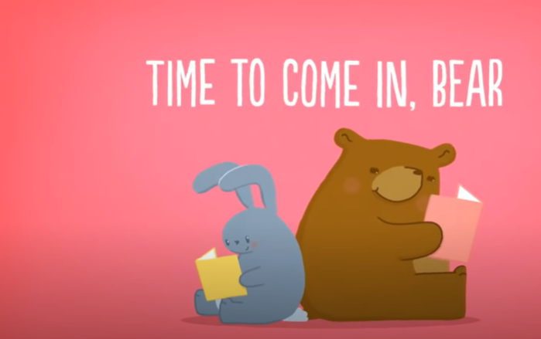
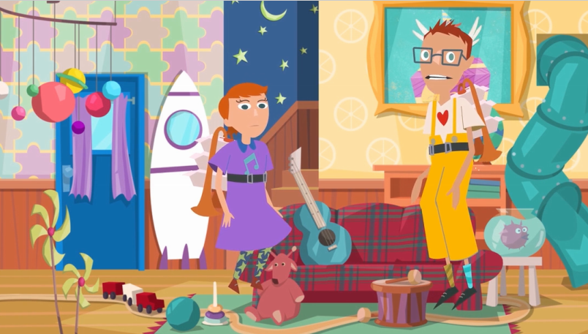
Covid -19 Resources for Parents
Below are some great stories about Covid-19 that are kindergarten friendly. Please watch the video first, before sharing with your child. Please only show this if you think it would benefit your child.
Rock Monsters
Coronavirus
Time To Come In, Bear
Hello!
Spike and Toody

Slide 29
Have a Great Summer…
…and we will
see you in
Kindergarten!

